Slide 1
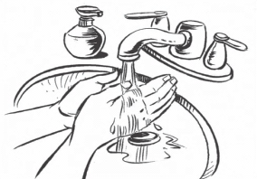
VAGINAL RING INSERTION INSTRUCTIONS
1
Wash your hands with soap and dry them on a clean cloth.
2
Get in the position that is most comfortable for you to insert the ring.
3
Hold and press the sides of the ring together. You may find it easier to insert the ring if you twist it into the shape of the number ‘8’.
4
Use your other hand to hold open the folds of skin around your vagina.
5
Place the tip of the ring in the vaginal opening and then use your finger to push the folded ring gently into your vagina.
6
Push it up towards your lower back as far as you can. If the ring feels uncomfortable, it is probably not inserted far enough into your vagina. Use your finger to push the ring up as far as you can into your vagina.
7
The ring should now be in your upper vagina. Wash your hands when you are done. If you have trouble, contact the clinic or come in for assistance.
MTN-036/IPM 047
Version 1.0 17 July 2017

Slide 2
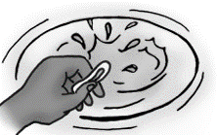
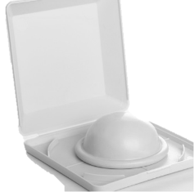
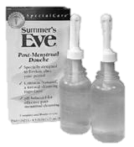
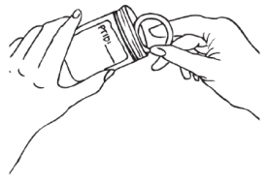
VAGINAL RING IMPORTANT INFORMATION
Leave ring inserted, all day, every day: The ring should be kept inserted at all times, including bathing.
If the ring falls or is taken out:
Somewhere clean: Try to reinsert the ring as soon as possible. If you cannot reinsert it right away, place the ring in the bag provided to you. Before you reinsert, rinse the ring in clean water (no soap permitted) and follow the insertion instructions on the other side.
Somewhere dirty (such as the toilet or the ground): Do NOT reinsert the ring. Instead, place it in the bag provided to you and contact the clinic as soon as possible (do not rinse before putting it in the bag).
Avoid and Abstain: Certain vaginal products, devices, and practices are prohibited during all of study participation or at specific time points before and after clinic visits. See the Study Adherence Guidelines handout for detailed information on this topic.
Do not Share: Insert only the ring assigned to you and do not share your ring with other women.
Storage: If the ring is removed and is not reinserted, place the ring in the bag provided to you and return it to the study clinic at your next visit (do not rinse the ring before putting it in the bag).
Transport: When returning an uninserted ring to the clinic, keep the bag with the ring inside it with you at all times to avoid loss.
Questions or Concerns: The study staff are here to help and support you. Please contact us between visits with any questions or concerns. [site to insert contact information]
MTN-036/IPM 047
Version 1.0 17 July 2017

